Slide 1
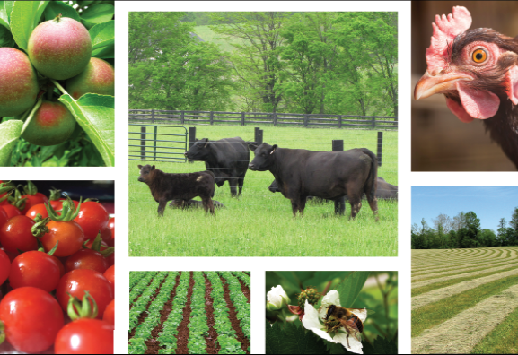



Kentucky Office of Agricultural Policy

Slide 2


FY22 Master Settlement Agreement Funds
Estimated Funds from tobacco companies, based on cigarette sales
$129,567,751
$26,601,200 is subtracted for the debt service on rural water and sewer lines
$400,000 is subtracted for compliance at state level
$250,000 is appropriated for Non-Participating Manufacturer Compliance
General Assembly Budget
$102,566,551
MSA Dollars Appropriated to:
Kentucky Agricultural Development Fund (KADF)
Early Childhood Development Fund (ECDF)
Health Care Improvement Fund (HCIF)
Agriculture
$52,176,075
Healthcare & Early Childhood Development
$50,390,476
KADF
$48,252,675
Farms to Food Banks
$500,000
Division of Conservation
$3,423,400
County Funds
$19,092,956
State Funds
$29,159,719
KAFC Loan Programs
KADF State Projects

Slide 3
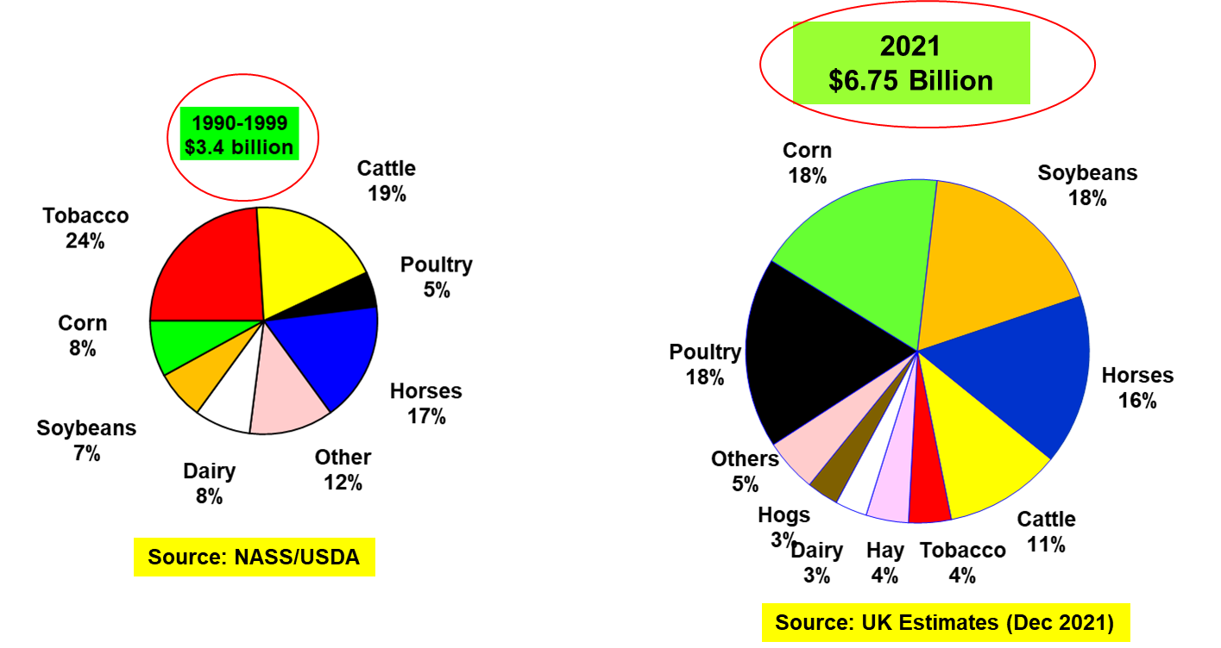
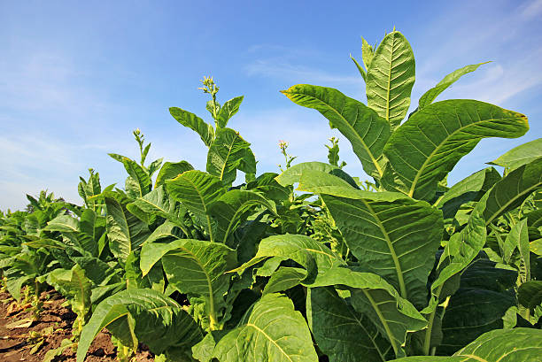
KY Agriculture in the 1990s
Distribution of
Kentucky
Agricultural
Cash Receipts
Tobacco was king!
Source: NASS/USDA
Notes:
In the 1990s Tobacco was King of Kentucky fields. Tobacco accounted for 24% of Kentucky’s agricultural cash receipts. Of Kentucky 90,000 farms over 45,000, or half, had a tobacco base. Here in Henderson County with over 526 farms and 96 depended on tobacco. In 1997, total cash receipts for Henderson county was $50 million an $1.5 million came from tobacco.

Slide 4
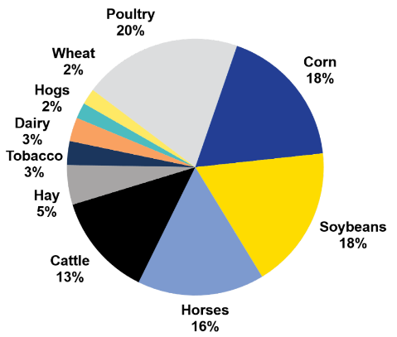
KADF Economic Impact
Distribution of Kentucky
Agricultural Cash Receipts
1990s vs 2022
2022
$8 billion
Source: NASS/USDA
Source: UK Estimates (Dec 2022)
Notes:
The investment of funds at the county and state level have helped Kentucky almost double Farm Cash Receipts since 2000.

Slide 5

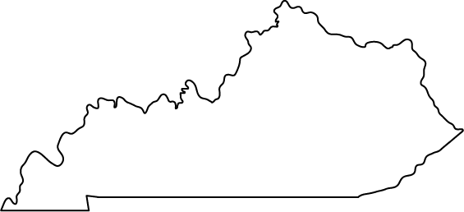
Investments in Kentucky
$709,351,489
Notes:
Over $708 million in Kentucky Agricultural Development Funds have been invested in projects over 20 years. Along with county level programs such as CAIP, these funds have been invested in projects that have impacted a wide range of agriculture endeavors including many in or impacting Eastern Kentucky: Grow Appalachian, KSU Small Grant Program, KY Highlands, Kentucky Beef Network, Kentucky Horticulture, Kentucky Proud, KCARD, and many more.

Slide 6

Soil Conservation District Impact
93 Counties
989 Grants
Over $104 Million Awarded
Notes:
Soil Conservation Districts in 93 counties have been awarded more than $104 million in 983 projects and programs over the past 20 years.

Slide 7
KADB Initiatives
County | FY23 Est. Tobacco Allocation | FY23 Est. State Funds
Bell | $ 209 | $ 29,791
Boyd | $ 1,936 | $ 28,064
Calloway | $ 27,969 | $ 2,031
Campbell | $ 26,880 | $ 3,120
Crittenden | $ 2,321 | $ 27,679
Floyd | $ 335 | $ 29,665
Fulton | $ 143 | $ 29,857
Harlan | $ 275 | $ 29,725
Hickman | $ 4,599 | $ 25,401
Hopkins | $ 17,319 | $ 12,681
Jefferson | $ 17,026 | $ 12,974
Knott | $ - | $ 30,000
Leslie | $ 4,407 | $ 25,593
Letcher | $ 82 | $ 29,918
Livingston | $ 949 | $ 29,051
Lyon | $ 24,975 | $ 5,025
Marshall | $ 26,046 | $ 3,954
Martin | $ 49 | $ 29,951
McCreary | $ 4,658 | $ 25,342
Perry | $ 2,861 | $ 27,139
Pike | $ - | $ 30,000
Union | $ 829 | $ 29,171
Webster | $ 18,169 | $ 11,831
Whitley | $ 27,876 | $ 2,124
Total | $ 209,913 | $ 510,087
  State Support to Limited Allocation Counties (SSLAC) Initiative for 2023 and 2024
    SSLAC 2023 and 2024 would provide state funds to counties with allocations below $30,000, based on 2023 and 2024 county allocations. The counties may use the funding for any project/program in line with the County’s Plan for Agricultural Development.
  Counties receiving SSLAC would be able to roll over any remaining funds for continued investment.

Slide 8

KADF Programs and Initiatives
County Ag Investment Program (CAIP)
Youth Ag Investment Program (YAIP)
Next Generation Farmer Program (NextGen)
Deceased Farm Animal Removal Program (DAR)
Shared-Use Equipment Program
Food Safety and Efficiency Incentives
Large and Food Animal Veterinary Incentives
On-Farm Energy Incentives
On-Farm Water Management
KADF project grants/loans
Notes:
The KY Agricultural Development Funds are invested at both the state and county level for programs to diversify agriculture. Along with grants we have developed many programs to address needs in our counties and on our farms. Soil Conservation has been integral to the implementation of these programs and projects at the county level.

Slide 9
County Agricultural Investment Program (CAIP)
2022 CAIP by the Numbers
Funds committed: $16,678,588
County participation: 91
Jan. – Dec.
$3,500
Median producer maximum
93
Percent using state minimum score
87
Percent offering all areas as primary
26
Number of counties offering 75/25 cost-share
20
Number of counties offering every other year (EOY)
Complete guidelines and program application are available at https://www.kyagr.com/agpolicy/Kentucky-Agricultural-Development-Fund-Applicants.html.

Slide 10
Investments in Kentucky
1,291
KAFC Loans Approved
totaling over
$184,395,192
Notes:
Along with investments by the Kentucky Agricultural Development Board, over $186 million has been approved in loans across Kentucky to help beginning farmers, agribusinesses, agriculture infrastructure, and more.

Slide 11

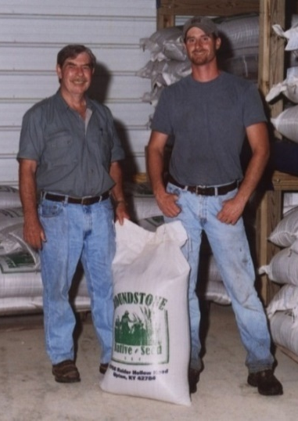
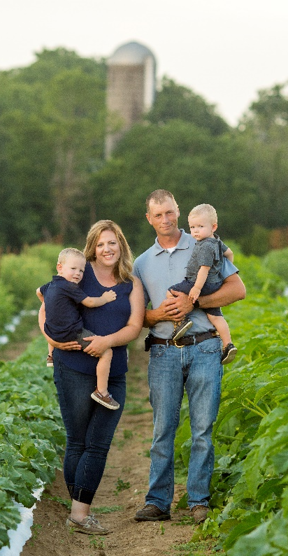
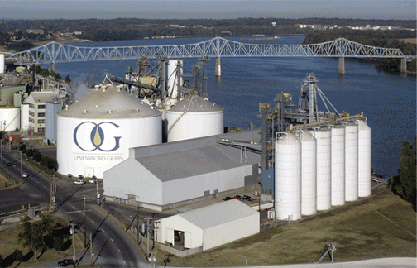

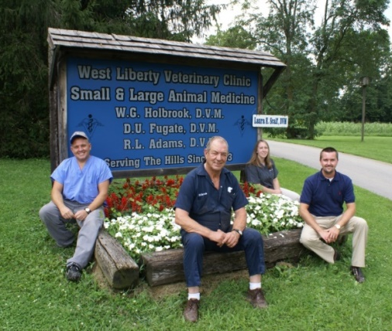

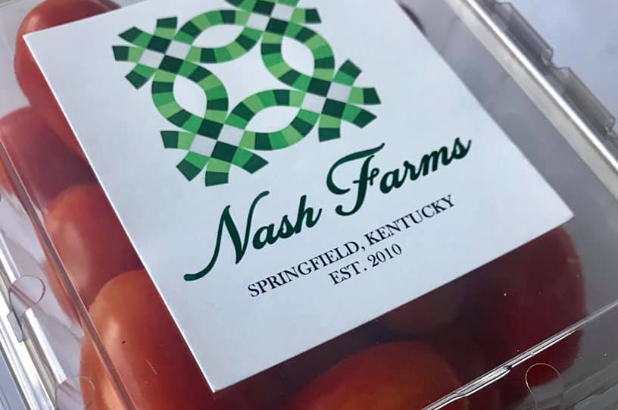
Available KAFC Loan Programs
Agricultural Infrastructure Program
Seed operation expansion in Hart Co.
Ag Processing Loan Program
Construct glycerin refinery in Daviess Co.
Diversification Through Entrepreneurship Program
Renovate building for welding school
in Fleming Co.
Beginning Farm Program
Purchase real estate
In Washington Co.
(Lender/KAFC/FSA)
Large/Food Animal Vet Program
Buy into existing veterinary practice
Morgan Co.
Notes:
The Kentucky Agriculture Development Board and the Kentucky Agricultural Finance Corporation are working together to provide grants and loans which have helped to diversify and grow Kentucky's agriculture and rural economy.

Slide 12
Contact
Kentucky Office of Agricultural Policy
404 Ann Street
Frankfort, KY 40601
(502) 564-4627
KOAP@ky.gov
http://kyagr.com/agpolicy
Notes:
Thank you again for the opportunity to be here this morning. If you have questions or need more information about our programs visit our website.

