Slide 1
Division of Conservation Update
March 2023

Slide 2
FY23 Cost Share
345 projects
$4.2 million awarded
Funds are based on the score of the individual application
The fewer funds that are available, the higher the score must be to receive funding

Slide 3
FY23 Cost Share
Cost share is awarded based on the individual application
Prevention of soil erosion
Protection of water quality
Priority given to animal manure (per the statute)
Cost share is very competitive
$12.9m in applications
$4.2m in award

Slide 4
Cost Share
High priority
Animal mortality facility, CNMP, Fence to remove animals from a stream, Grade stabilization structure, HUA (feeding pads), Riparian forest buffer, Waste storage facility, Water facility
Medium priority
Critical area planting, Field border, Terrace
Low priority
Fence to divide a field, HUA (gate openings), Water facility (ramp in pond), Water well

Slide 5
FY23 map

Slide 6
Cost Share
Modifications
If you need to make a change to a cost share project, complete a Modification form and include the information about the change
Change in units of a practice (e.g., 200 foot more of fence)
Name changes
Deletion of practices
Modifications that change practices will be re-scored to verify that they would have been eligible for funding if they applied for those practices initially
Overrun
Complete when the units of a practice haven't changed but have cost more than the estimate.
Remember - the statute says 75% of the actual cost verified by receipt, voucher or bill

Slide 7
Cost Share Dates
FY21
Must have been completed by 3/1/23
FY22
First extension due 2/1/23
Second extension due 8/1/23
Must be complete by 2/1/24
FY23
Awarded 2/22/23
First extension due 3/1/24
Second extension due 9/1/24
Must be completed by 3/1/25

Slide 8
Audits
Working with Tichenor to get all of the FY20, FY21 and FY22 complete
Modifying Tichenor contract to add all of the special audits. This modification doesn’t come out of direct aid.
Special audits (over $500k) from FY20, FY21 and FY22 were recently billed

Slide 9
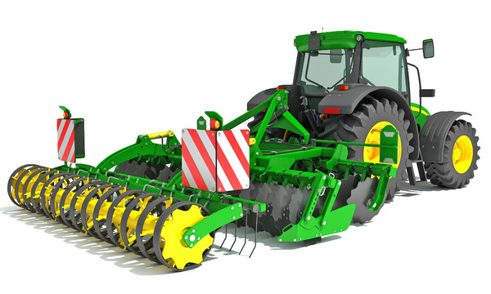
Equipment Loans
Still $800k available for loans to districts
Ask early – we must check if equipment is available on price contract. Not everything can be purchased from your local dealer.
Any legislative changes won't take effect until July 1st.

Slide 10
eec.ky.gov/AgWater More than 2700 online plans done since 6/1/21!

Slide 11
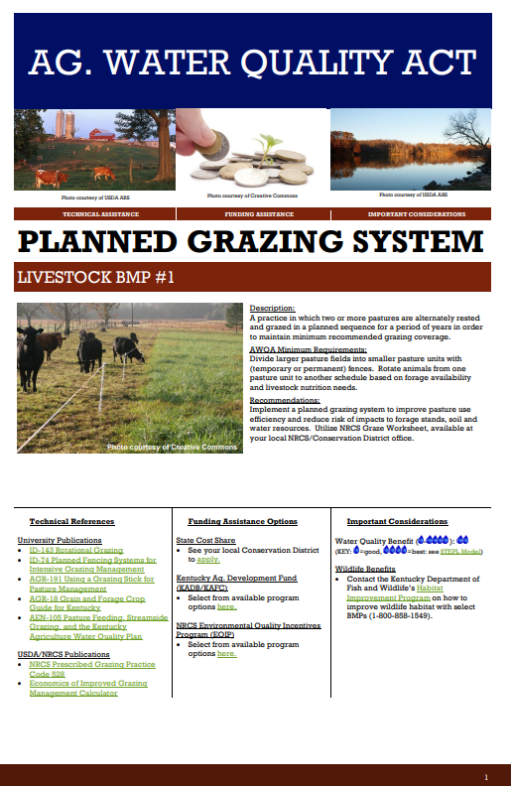
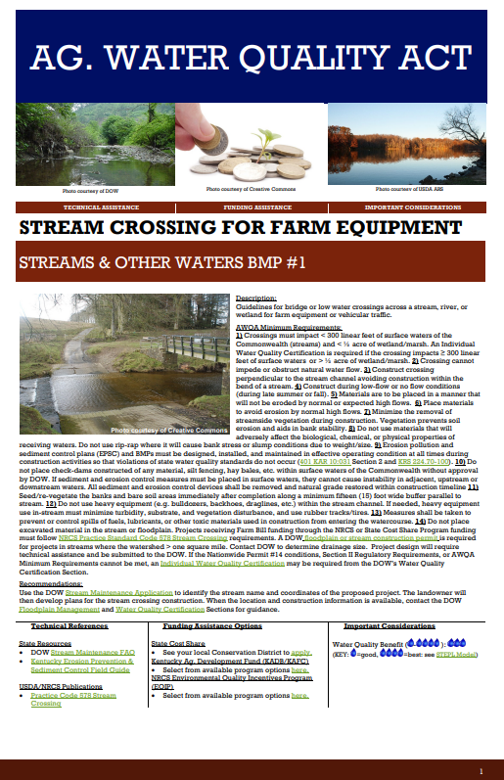
https://eec.ky.gov/Natural-Resources/Conservation/Pages/Best-Management-Practices.aspx
Notes:
Great BMP information available as hotlinks in the plan or on the page at the bottom of the slide

Slide 12
Notes:
Division of Water has outlined parts of 27 counties as priority areas. These areas have already gotten some signs to give out to people doing AWQA plans. May have some other

Slide 13
Nutrient Management Plans
If you have a farmer that needs a Ky Nutrient Management Plan (not a CNMP), send the request to Conservation@ky.gov
When you submit the request, have them start gathering information.
Recent soil test for fields where manure is currently spread and a map of those fields
Manure samples
Animal numbers
Feeding facilities and rations
Manure storage information – stackpad or lagoon

Slide 14
Trainings
Ten-minute trainings – focus on high priority cost share practices
If you have a topic of interest, please let your field rep know or email Conservation@ky.gov

Slide 15
Questions
Paulette.Akers@ky.gov
502-782-6300
Johnna.McHugh@ky.gov
502-782-6703
Conservation@ky.gov

