Slide 2
KDFWR PRIVATE LANDS PROGRAM
Restructured in 2020

Slide 3
Restructure
Private Lands Biologist
Regional Biologist
Farm Bill Biologist
Private Lands Biologist

Slide 4
Things that happened in reconstruction
Establish a Private lands coordinator
^{Hire Private Lands Biologist}
Regional Biologist cover more counties

Slide 5
New Regional Biologist Duties
Animal Damage
Research projects on WMA
CWD
Survevy’s

Slide 6
New Private Lands Biologist Duties
Give private land owners Technical Guidance
Work with Farm Bill programs to implement practices
Work with NRCS on contract Wildlife related practices

Slide 7
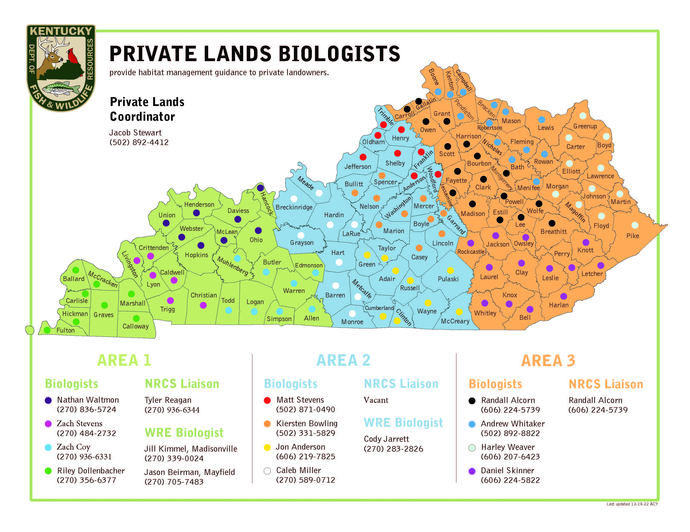

Slide 8
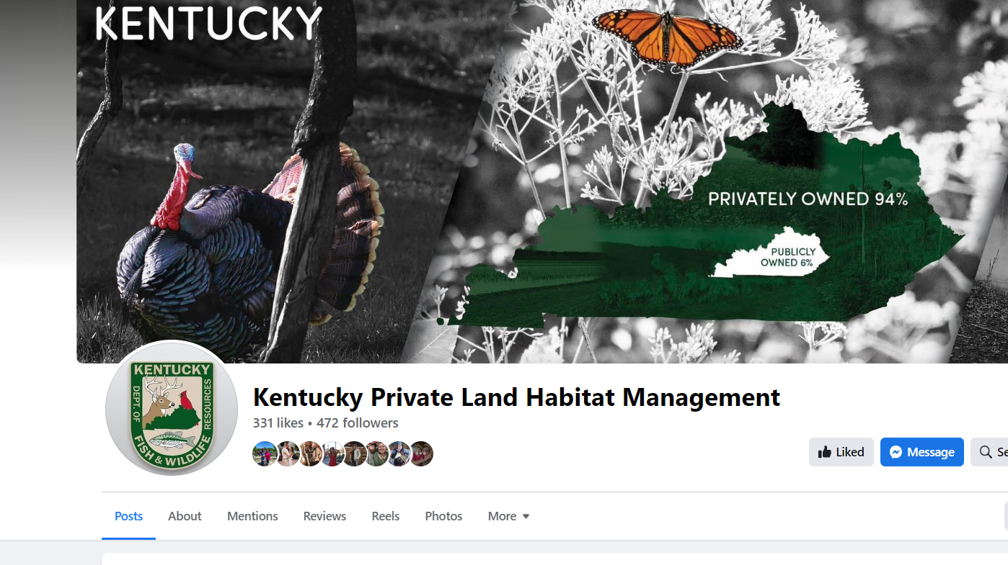

Slide 9
How can KDFWR Private lands staff help Conservation Districts?
Guidance on wildlife practices for landowners
Field Days
Help Districts with guidance on Local Cost-Share

